Slide 1
Monitoring Django Applications with Logstash

Slide 2
About me
Thomas Aglassinger
http://www.roskakori.at
@TAglassinger

Slide 3
Agenda
Overview:
Installation
Python logging to logstash
Elastic common schema (ECS)
Apache logs
Lessons learned

Slide 4
Overview

Slide 5
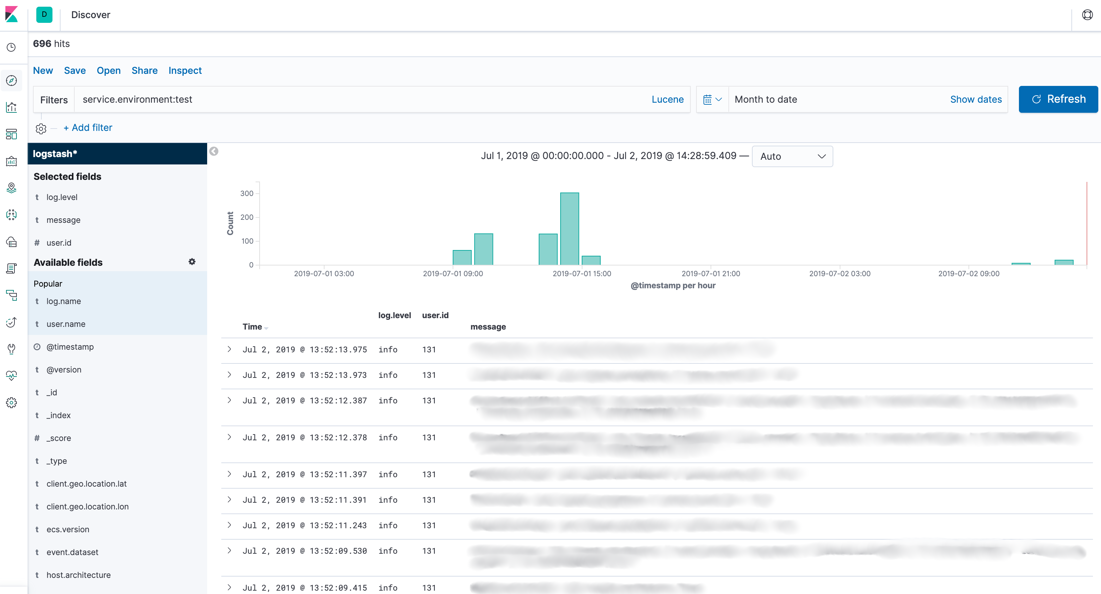
Goal 1: search logs from various sources
Search query
Time range
Log details
Fields available
for log entries

Slide 6
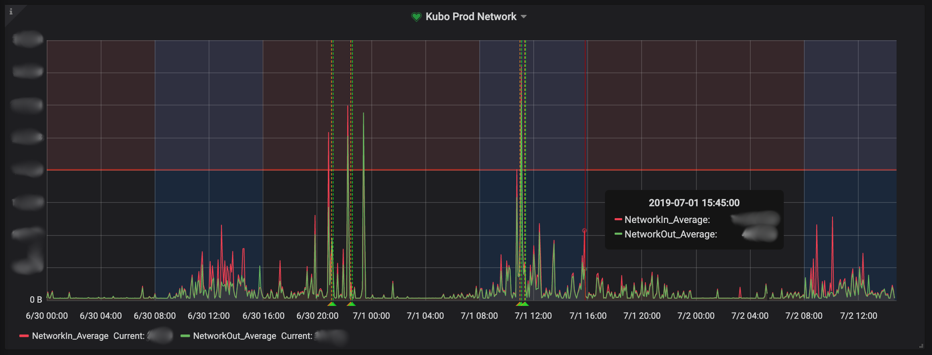
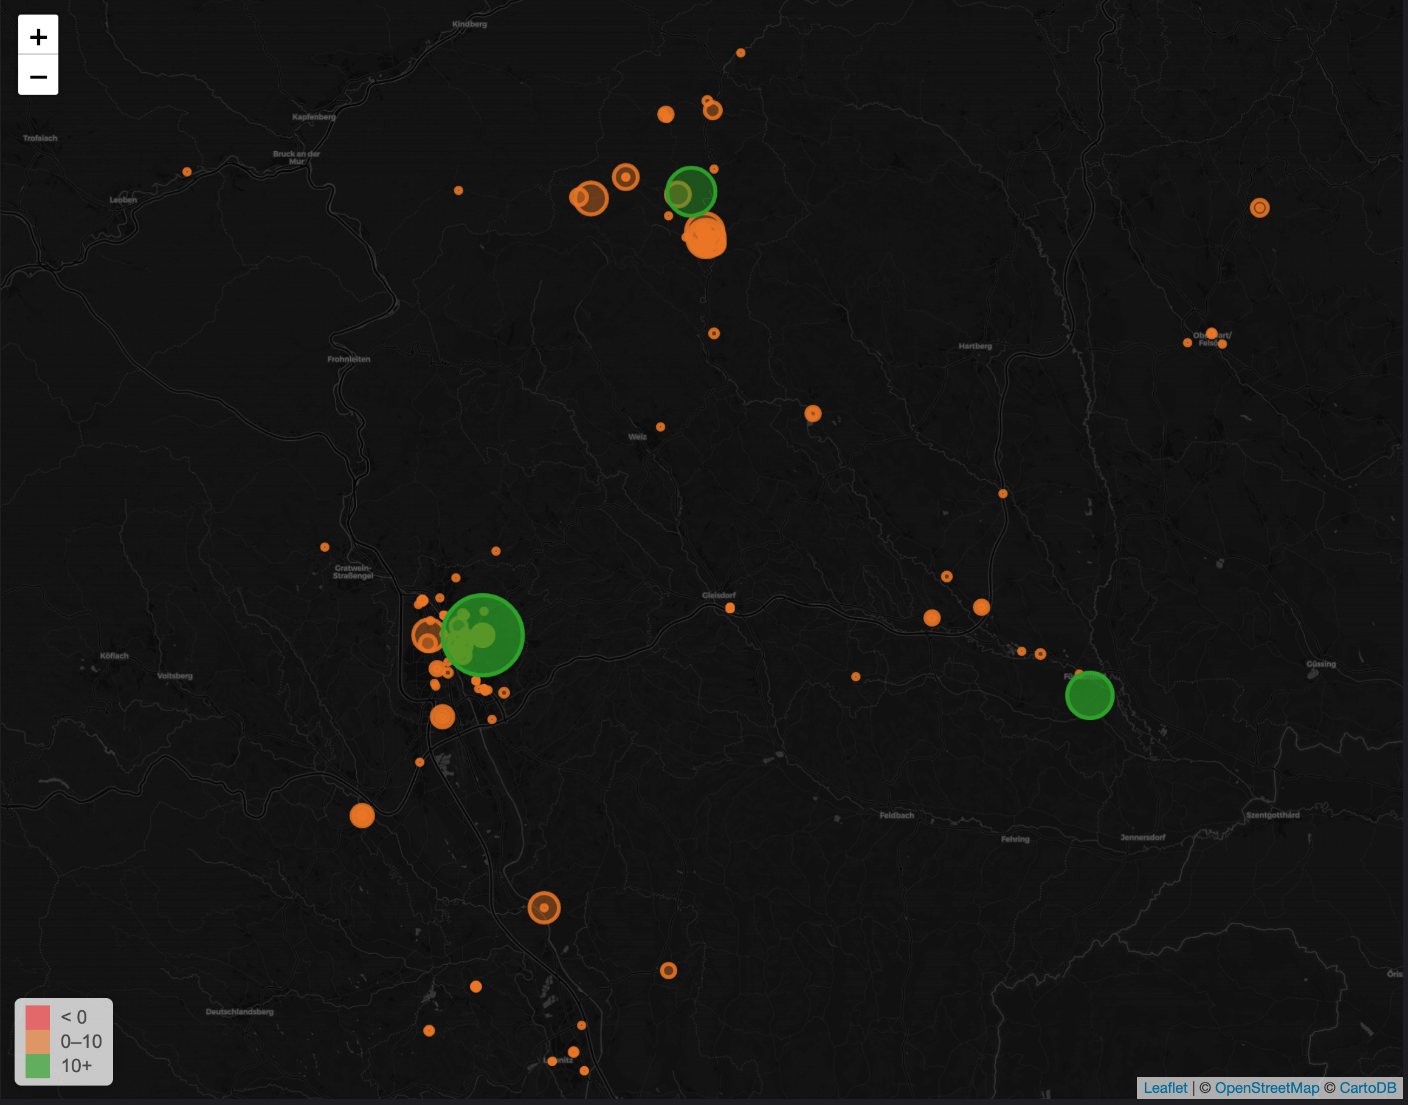
Goal 2: Reports, KPI’s and alerts

Slide 7
Basic architecture
Django
application
Django application happily runs and provides value.
Classic logging goes to console or logging files.

Slide 8
Basic architecture
Django
application
Django application can also use logging handler to log directly to logstash.
Logstash
Logstash collects, transforms and forwards logging data from different sources to central storage.

Slide 9
Basic architecture
Django
application
Elasticsearch is a search and analytics engine and popular storage for logstash.
Logstash
Elasticsearch

Slide 10
Basic architecture
Grafana can create reports from many different sources
Kibana can search logs stored in Elasticsearch
Kibana
reports
Grafana
reports
Django
application
Logstash
Elasticsearch

Slide 11
Basic architecture
Apache can run Django applications as a “real” web server.
Apache Web Server with mod_wsgi
Kibana
reports
Grafana
reports
Django
application
Logstash
Elasticsearch

Slide 12
Basic architecture
Apache Web Server with mod_wsgi
Kibana
reports
Grafana
reports
Apache log files contain information about web access, errors and request times.
Log
files
Django
application
Logstash
Elasticsearch

Slide 13
Basic architecture
Filebeats “listens” to log files and forwards new lines to logstash.
Apache Web Server with mod_wsgi
Kibana
reports
Grafana
reports
Log
files
Django
application
Filebeats
Logstash
Elasticsearch

Slide 14
Installation

Slide 15
First question to ask right now
Elasticsearch 6.x or 7.x?
6.x: messy but works
7.x: less messy but forums and stackoverflow become largely useless

Slide 17
Elasticsearch
7.0
160
breaking changes

Slide 18


Slide 19


Slide 20
Ways to install ELK
Whatever your cloud provider forces you to use.
Your favourite package manager (apt-get, brew, …) → currently mostly 6.x.
Download from https://www.elastic.co/downloads/logstash → any version but messy
Docker: https://elk-docker.readthedocs.io/ → any version, after updates small delay, “docker is broken again WTF?”
If you just want to get started and play with it: docker

Slide 21

Resource usage
Bloated because of Java culture

Slide 22
Python Logstash handler

Slide 23
Python Logstash handler
Various implementations on PyPI.
Prefer asynchronous solution
→ application does not have to wait for log message to be received by logstash
Recommendation: https://pypi.org/project/python-logstash-async/

Slide 24
python-logstash-async
Works very well with ELK 6.x.
Fails with ELK 7.x because of ECS
→ more later
Fix by ITELL.SOLUTIONS is underway: https://github.com/eht16/python-logstash-async/issues/39

Slide 25
Example configuration
# Add logstash
LOGGING['formatters']['logstash'] = {
'()': 'logstash_async.formatter.DjangoLogstashFormatter',
'fqdn': False,
'extra_prefix': None,
'extra': {
# Standard ECS fields
'organisation.id': 'itell',
'service.name': 'kubo_backend',
# Non standard fields for ECS standard objects
'service.environment': 'test',
'service.project_path': BASE_DIR,
},
}
LOGGING['handlers']['logstash'] = {
'level': 'DEBUG',
'class': 'logstash_async.handler.AsynchronousLogstashHandler',
'formatter': 'logstash',
'transport': 'logstash_async.transport.BeatsTransport',
'host': 'elk.example.com',
'port': 5959,
'database_path': f'{BASE_DIR}/logstash.db',
}
Fields depending
on your application
and organisation
Server where ELK
stack is running

Slide 26
Elastic common schema (ECS)

Slide 27
Until ELK 6.x
Same things have different names, e.g. user name:
  user
  username
  user_name
  user.name
Cannot simply copy and paste example from forums, stackoverflow, …
If you use different field names for different log source, you cannot spawn one query over different sources
(Optional fields are ok though, the just don’t show in the log and if missing are skipped concerning filter conditions)

Slide 28
Starting with ELK 7.x
Common set of fields
Same things should have same name (e.g. user.name)
Similar things have similar structure
(e.g. client and server)
Currently still somewhat immature and a moving target, but already quite useful
https://github.com/elastic/ecs

Slide 29
Major breaking points
Some value fields turned into object fields
  user → user.name, user.id
  client → client.ip, client.port, ...
  server → server.ip, server.port, …
Some fields moved, for example:
  http_status → http.response.status_code
Result: logstash will not forward such messages to Elasticsearch at all → monitor logstash log for errors

Slide 30
Parsing Apache logs

Slide 31
Lessons learned

Slide 32
Lessons learned
ELK is bloat.
ELK is breaking changes.
ELK is quickly paywalled.
Everyone uses it but it is still crap.
If we would do it again: more research probably use a simpler solution (syslogd, monitoring systems like sentinel, ES without logstash, …)
Python-logstash-async is pretty cool and integrates well with Django.
Grafana rocks!

